Slide 1
Cat Modeling and the RI Placement + Market Files
TIGERRISK PARTNERS

Slide 2
Agenda
01.
Cat Modeling in Reinsurance Placement Process
Market Files
Prepping Market Files
Portal

Slide 3
Cat Modeling in Reinsurance Placement Process
Cat Modeling Analyzes Client Data to Help Client and Brokers see Reinsurance needs for:
Peril Exposed Areas
High Concentration Areas
Size of Potential Losses
Broker develops Structure to Present to Markets to Buy
Cat Modeling Helps Compile Quantitative Submission and Market Files to Provide to the Reinsurers
Cat Modeling Assists in Answering Data Questions from Reinsurers during

Slide 4
Market Files
Quantitative Data provided to the Reinsurers for them to Independently Evaluate the View of Risk and Impact to their Portfolios
Submission (Excel spreadsheet) – Used by Reinsurance Underwriters (UWs)
Contains Profiling Tables Highlighting Exposure Data Breakouts
Comparisons Year-over-Year in Exposure
Potentially Includes Projected Growth Factors
Historical Claims and Rate Information from Brokers/Clients
Brokers Generally “own” this Document
Paired with a Word Document called the Narrative – describing the company and various qualitative items to consider
Actual Model Files (zipped data) – Used by Reinsurance Cat Modelers
Exposure Files (EDM, CEDE, Unicede Files)
Loss Files (RDM, CLFs, YLTs)
Modelers “own” these Files
Model Transmittal Document (PDF) – Used by Reinsurance Cat Modelers
File Provided by the Cat Modeling Department Along with Actual Model Files
Summarizes Data Provided, Relevant Perils to Run, Underlying Reinsurance to apply (QS, XPR, etc)
If Growth Factors Need to be Applied
EP Summaries that Tie to Data Provided
Modelers “own” these Files

Slide 5
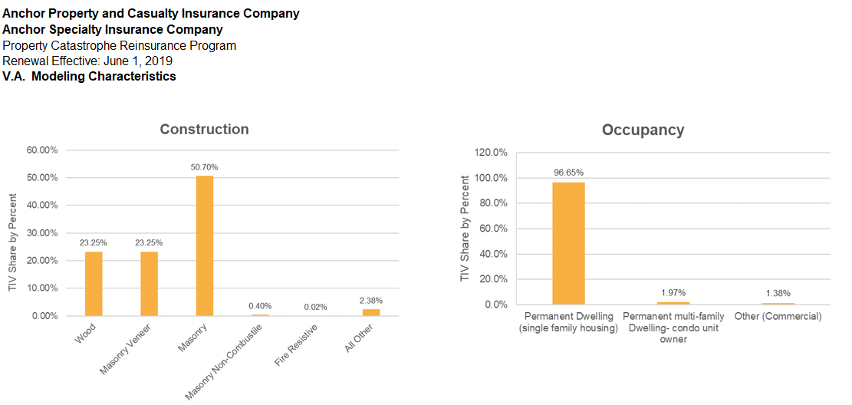
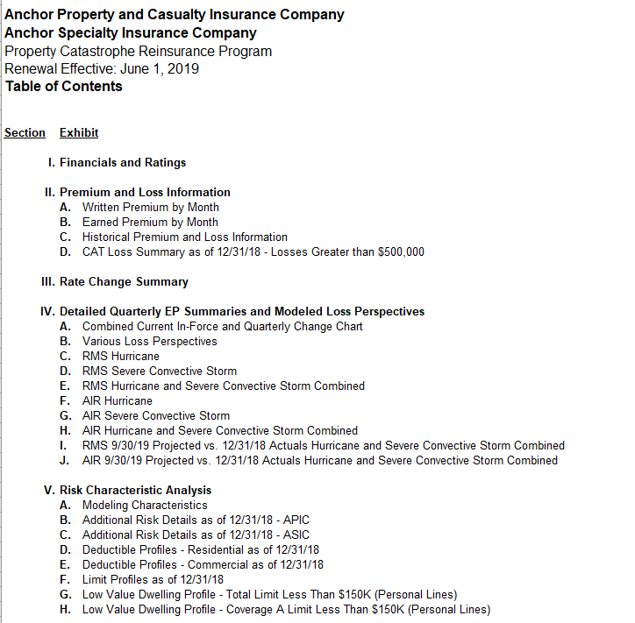
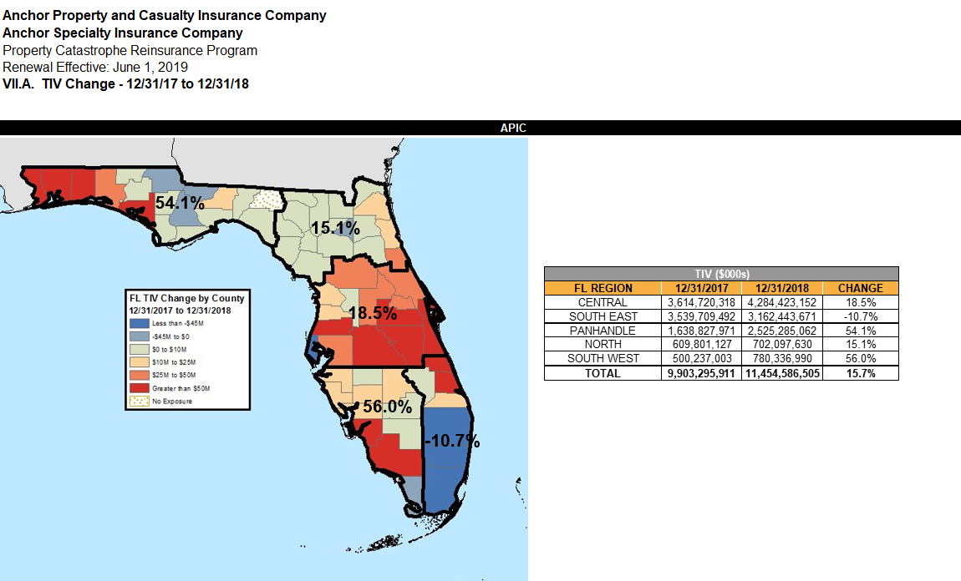
Market Files – Submission Screen Shots

Slide 6
Prepping Market Files
IMPORTANT: Always Double Check and Confirm with Others data that is sent externally
Copy Exposure Portfolios to a Clean/New Database
Clean Out Proprietary Client Data (e.g. Premium, Insured Name, User Defined Fields)
Use Export Exposure Data Function in Touchstone Software - Uncheck These Fields
Use Market Prep SQL Script for RMS
Run or Copy RMS Losses to a Clean Database
Usually on a State Level Basis
Potentially Include both LT and NT runs depending on Client/Broker viewpoint
Include all Relevant Perils
Make sure Everything is Labeled Clearly
Run AIR Losses to CLF (company loss files)
Loss files that can be imported into Touchstone Re for Structure Manipulation
Loss Data is Stored at a LOB and County Level – must run at this level to export
Depending on Reinsurers, can group CLFs in Touchstone RE
Confirm Exported CLF Results in Touchstone RE
May Provide YLTs upon Request or for Complicated Projections
Confirm with Brokers Data to Be Sent
Populate the Transmittal Document and Share with Brokers for Confirmation
Post on Portal with Transmittal Doc

Slide 7
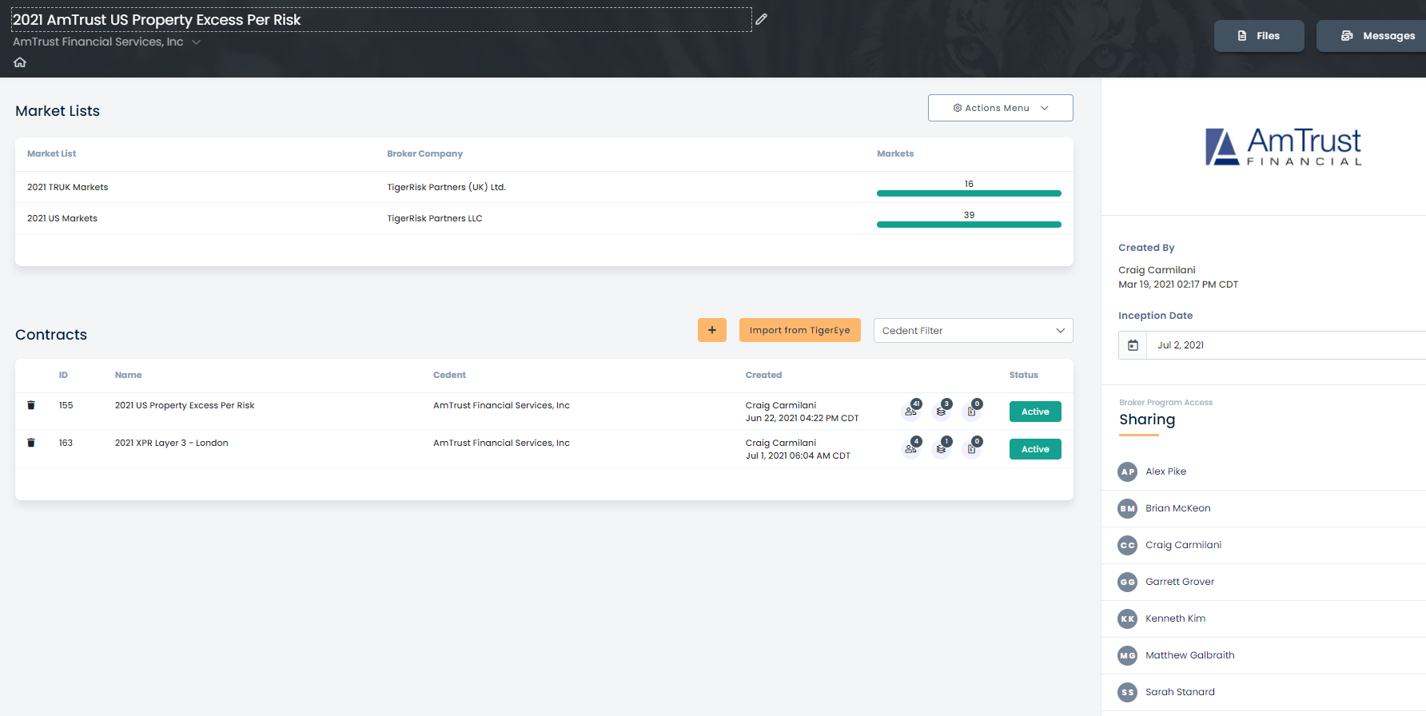
Portal
Reinsurance Program Sharing and Marketing Storage Site
Can Send Messages to Markets Via Portal
Brokers Set Up Initial Placement on Portal
https://portal.tigerrisk.com/login

Slide 8

Questions?

Slide 9


